Slide 1
Name : Swapnil Ghosh Department : IT
Roll : 001911001067
TASK 2

Slide 2
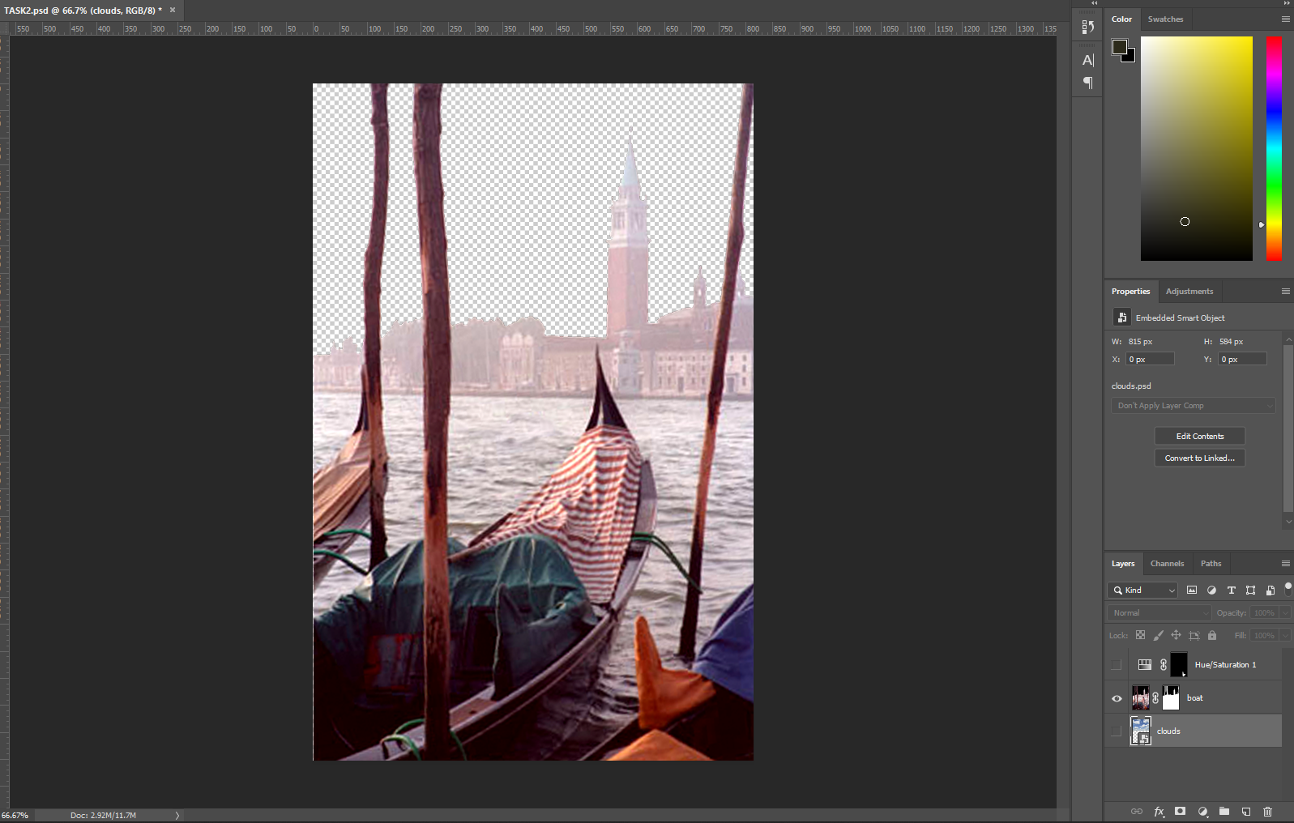
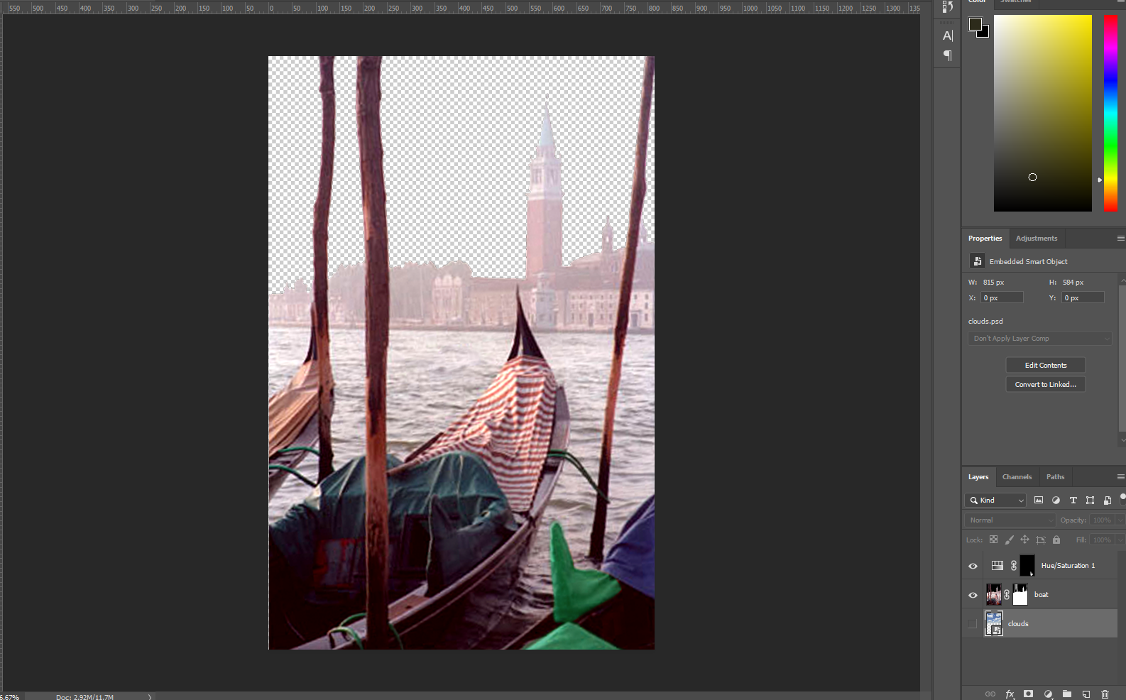
Step- 1) Opened the File BOAT.psd in Photoshop
Step- 2) First I discard the black border and aligned the image using Crop tool
Step- 3) Then adjusted the brightness and contrast using Level Function
Step- 4) I used Rectangular Marquee tool to draw border a border around orange tarpaulin
Step- 5) Used Replace Color function to change color of Orange tarpaulin to green using the Eyedropper tool, and used slider to change color.

Slide 3
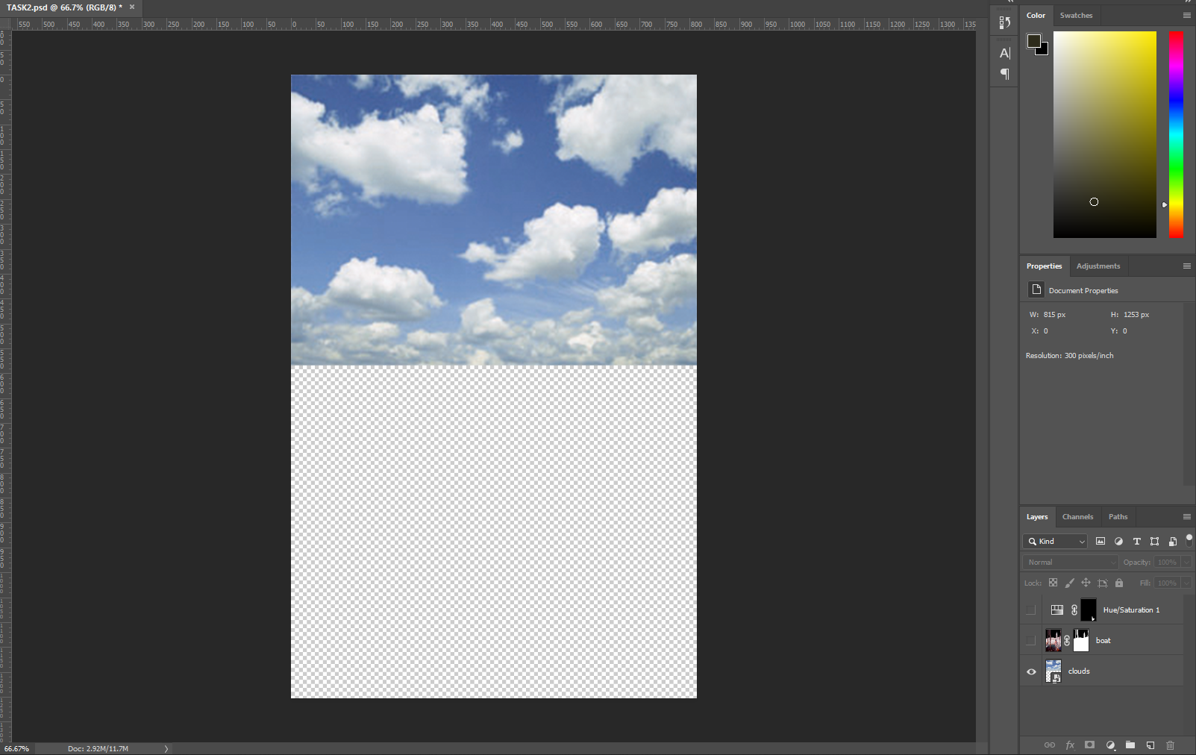
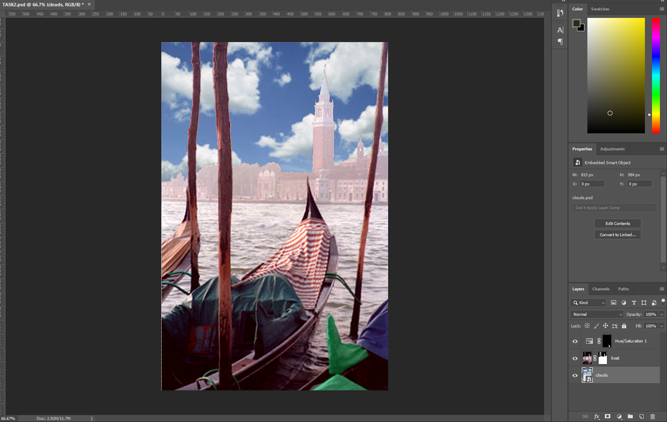
Step- 6) Used the Sponge tool to saturate the colors of the boat and neighbouring objects.
Step- 7) Used the Clone Stamp tool to remove the boat in the background.
Step- 8) Used the Magic Wand tool to select the sky.
Step- 9) Opened the Original Image again, and integrated the layering.
The End

